Slide 1




CarpentriesOffline What is it and why do we need it?
Jannetta S. Steyn (PhD)
Newcastle University

Slide 2
Quick history
Collaborations Workshop 2021 HackDay Winner
2022 SSI fellowship
Running Carpentries workshops without Internet access

Slide 3
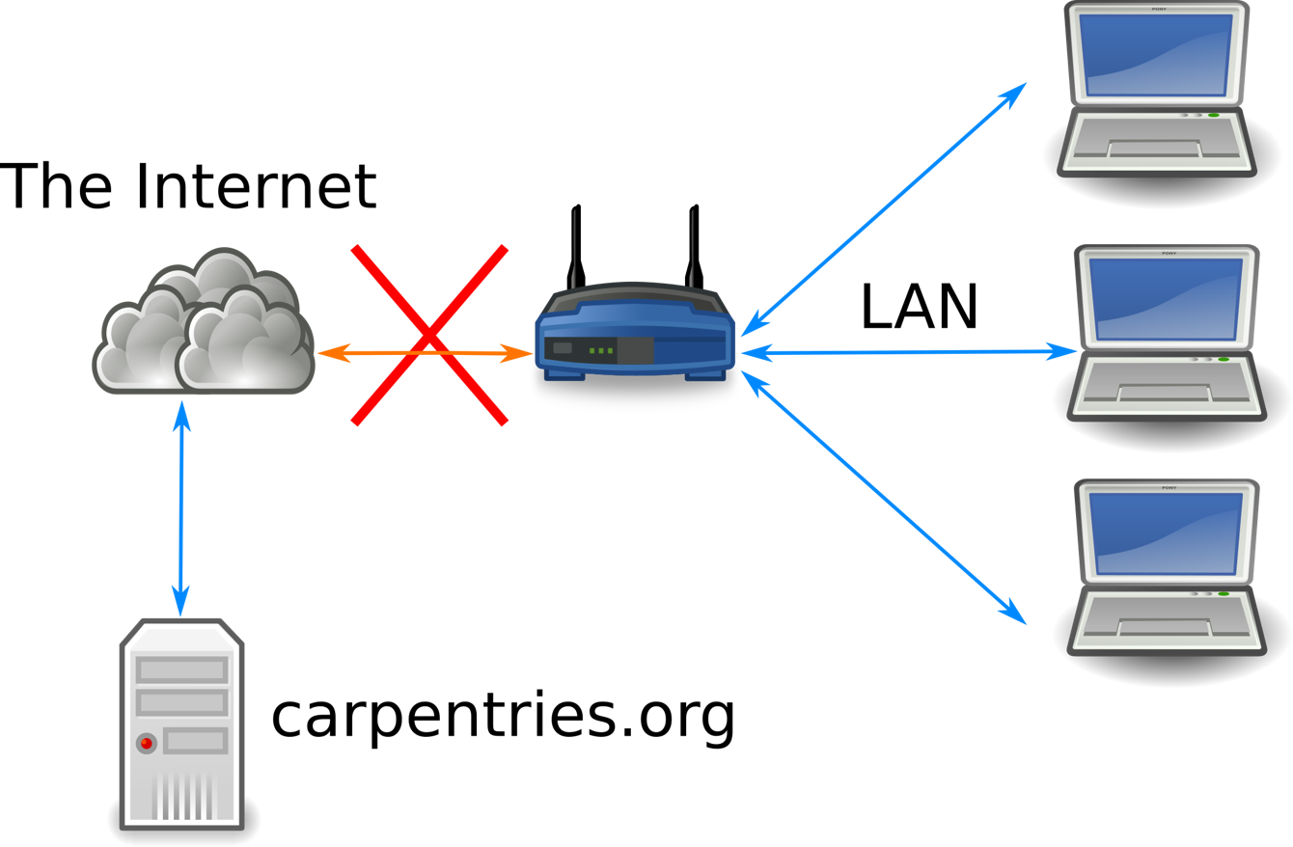
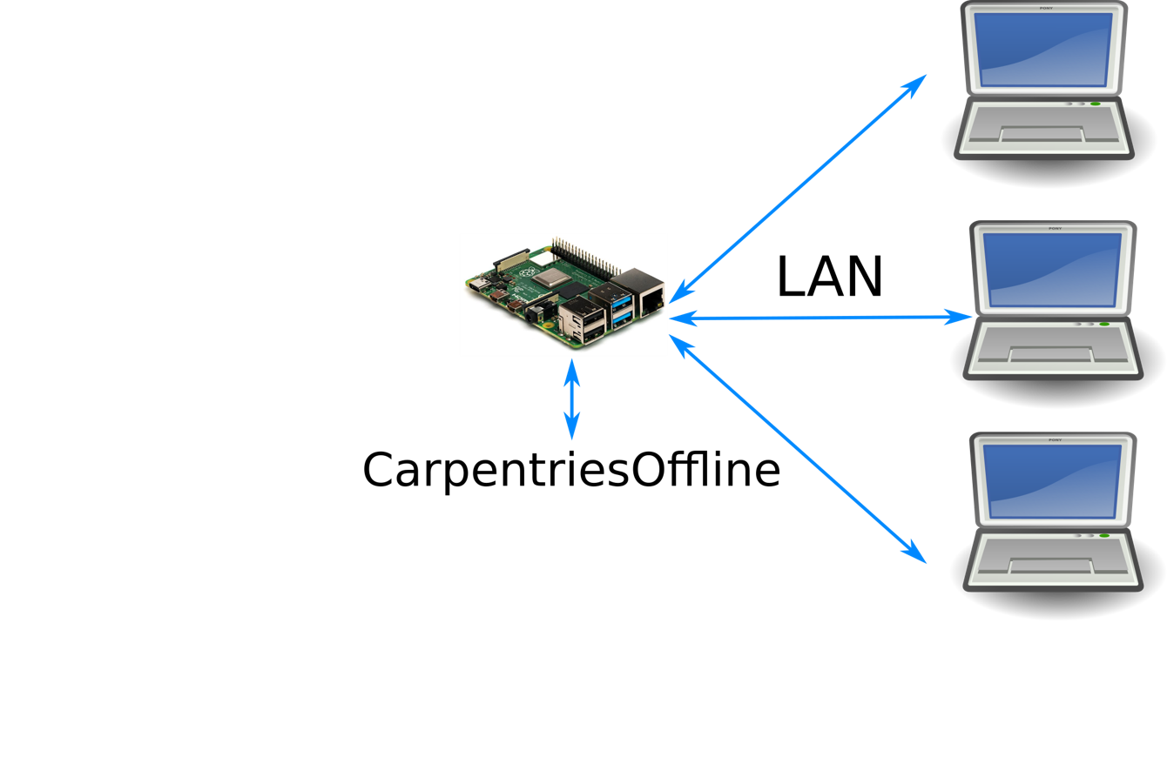
CarpentriesOffline Concept
The Problem
The Solution

Slide 4
Progress
https://carpentriesoffline.org
Downloadable SD card image for Raspberry Pi
Python package: offlinedatasci
Bootable Flash drive
miniHPC

Slide 5
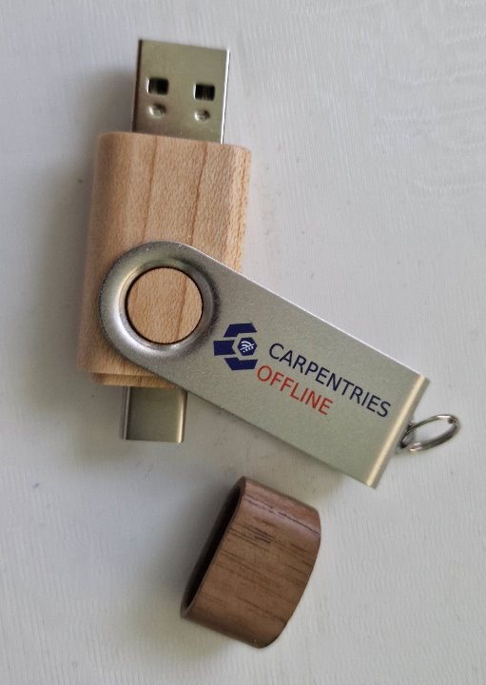
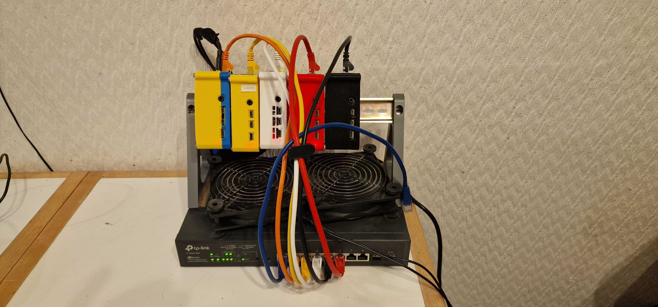
CarpentriesOffline Concept
The Problem
The Solution

Slide 6
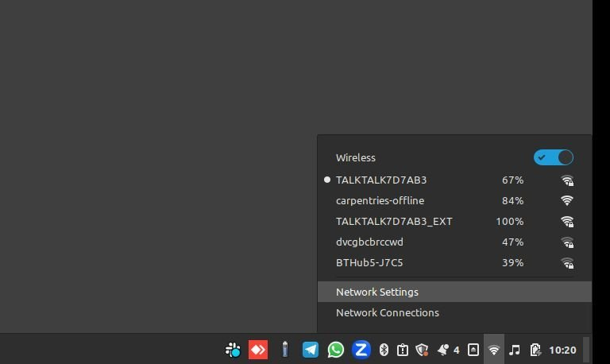
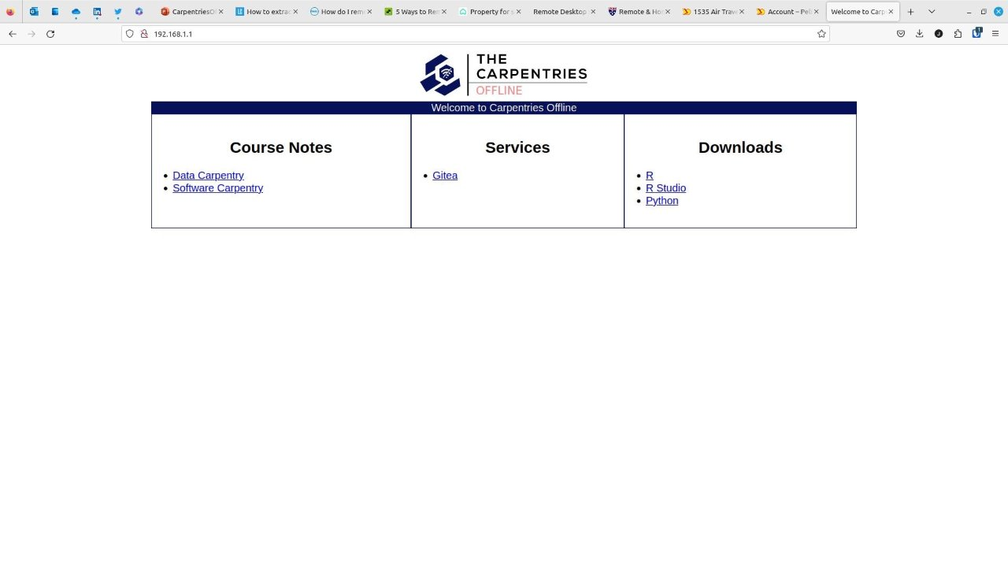

Slide 7
What is a High Perfomance Computer (HPC)?

Slide 8
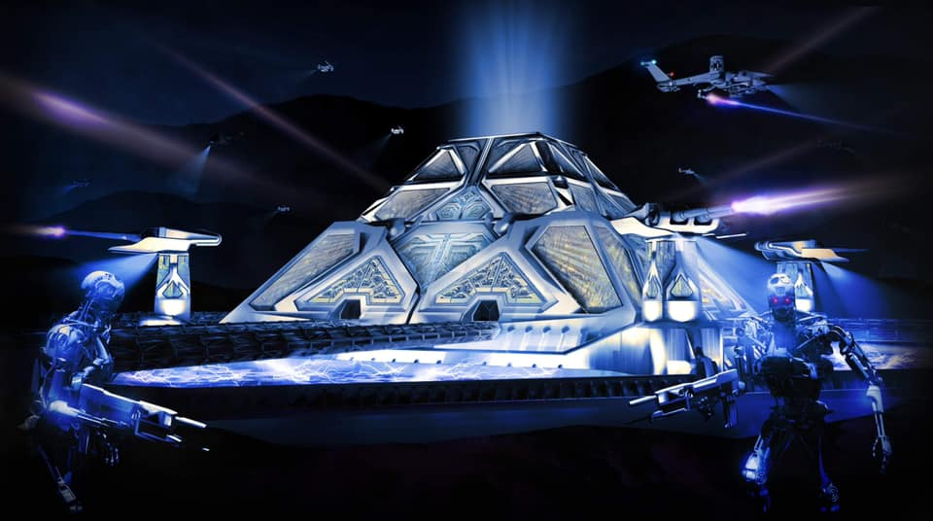
Skynet Pyramid
Fan art: https://www.facebook.com/photo/?fbid=606678917373695&set=a.121895769185348

Slide 9

Hal 9000

Slide 10
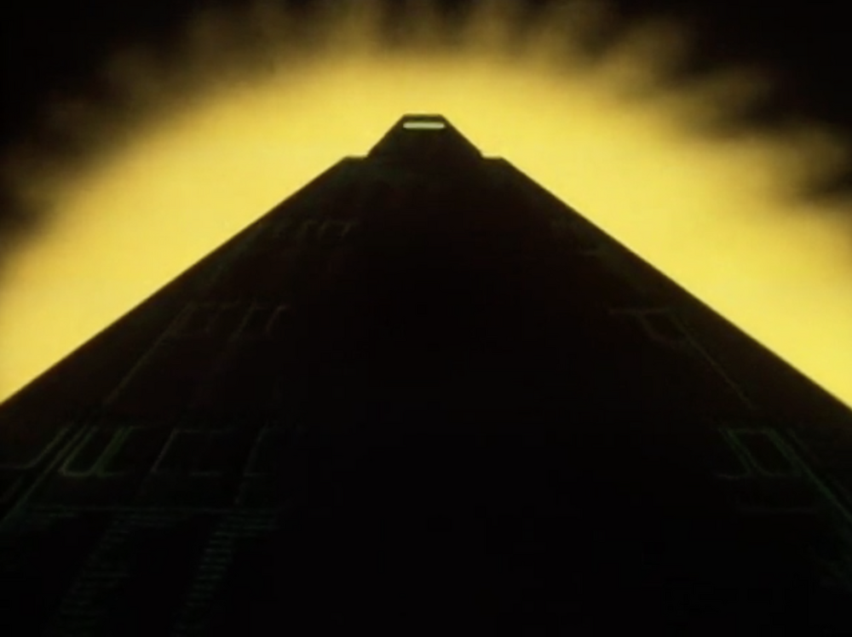
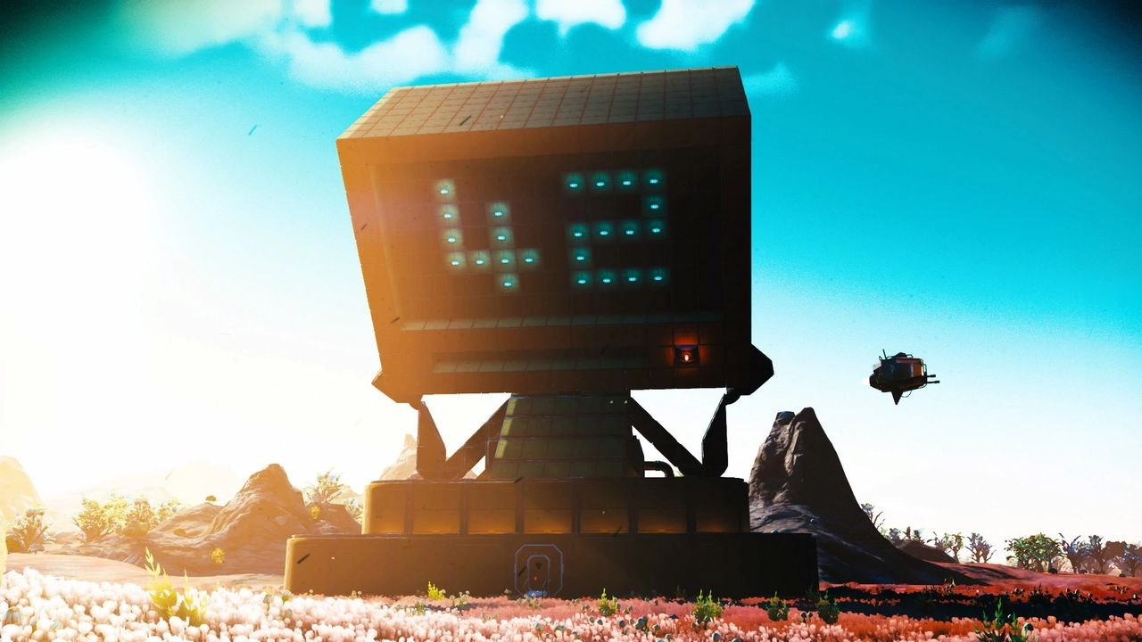
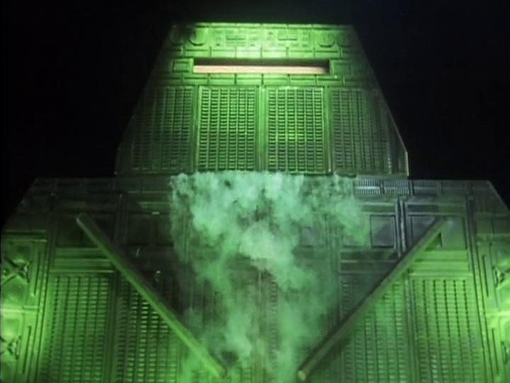
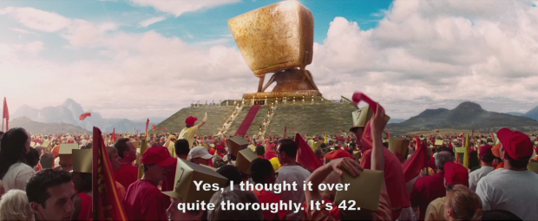
Deep Thought
https://hitchhikers.fandom.com/wiki/Deep_Thought

Slide 11

Blue Gene

Slide 12
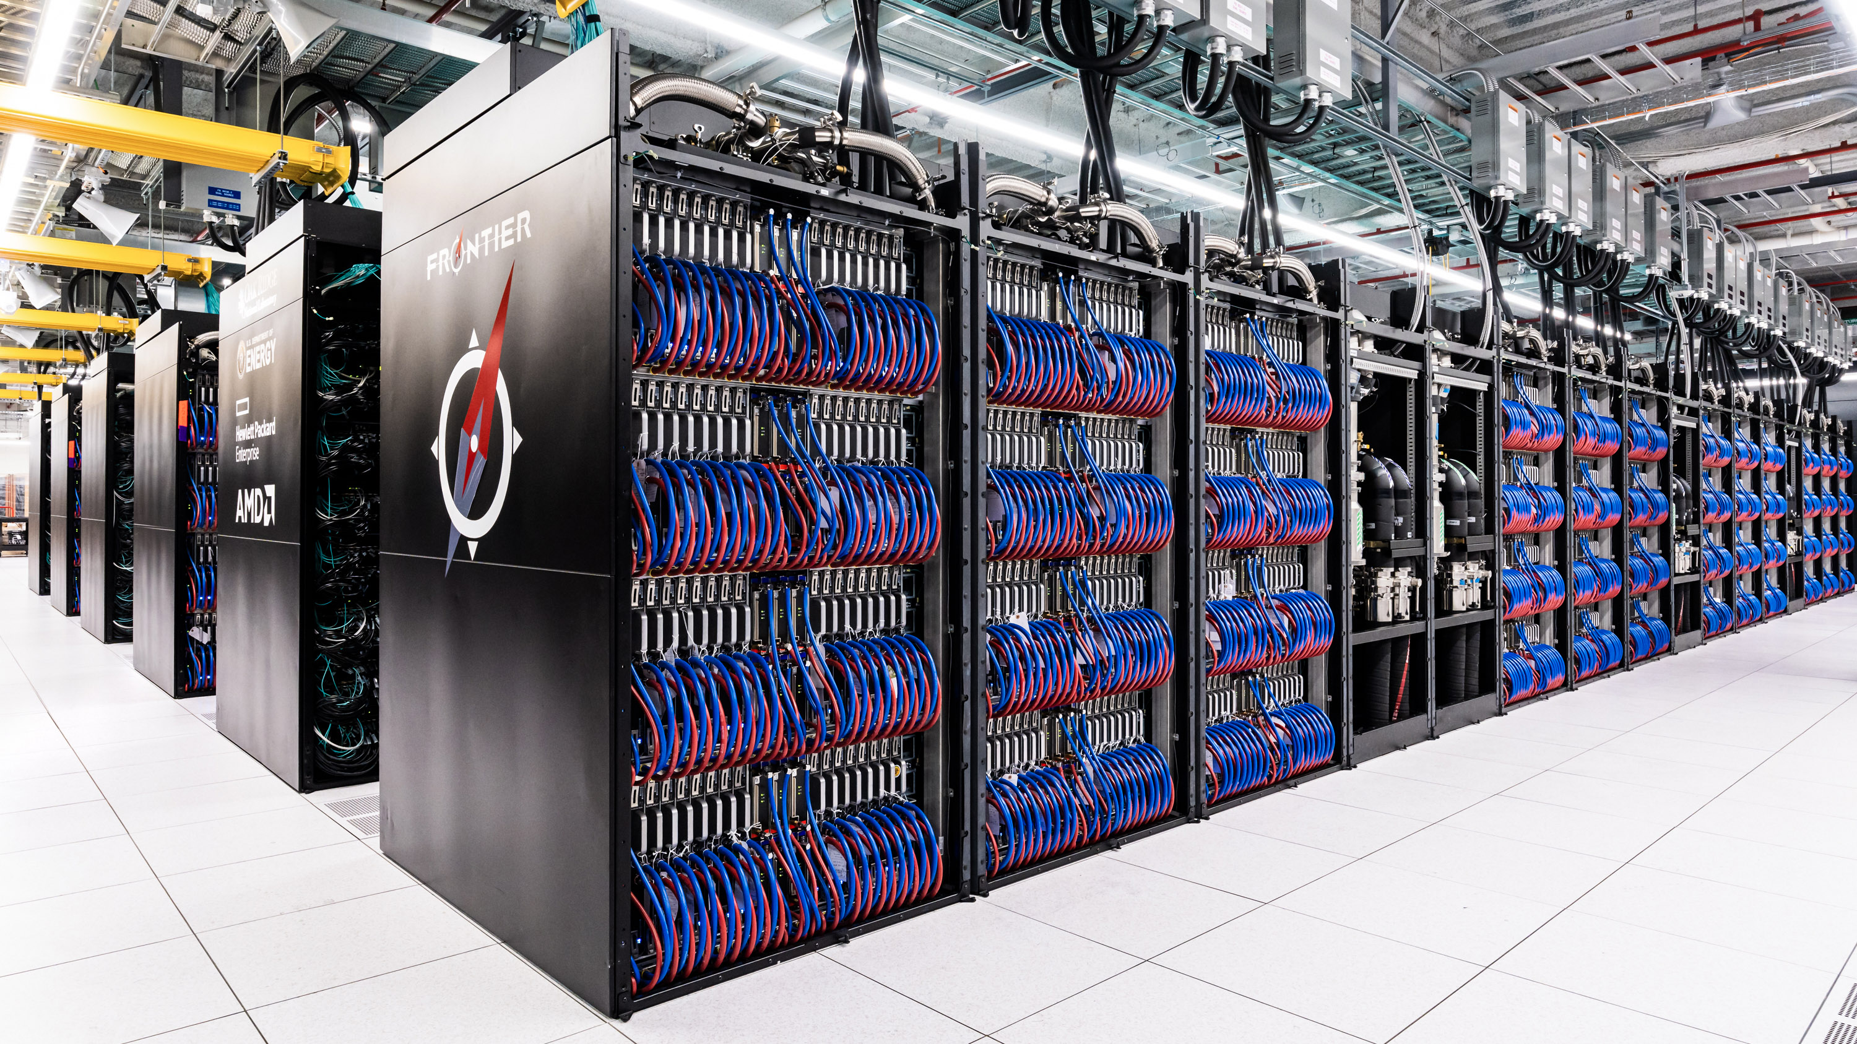
Frontier
Frontier, an exascale-class machine at Oak Ridge National Laboratory.

Slide 13

High Performance Computing
High-performance computing (HPC) uses supercomputers and computer clusters to solve advanced computation problems. (Wikipedia)
High performance computing (HPC) is the practice of aggregating computing resources to gain performance greater than that of a single workstation, server, or computer. (Google)

Slide 14
Why a mini version?
Hardware less abstract
Real system are busy doing actual research (85 - 95% load on systems)
Fear amongst learners that they are going to break the multi-million system they are playing on
Resource limits more apparent
More control over the environment
No need to have accounts on a real HPC
Own access point, so no need to get people on university network

Slide 15
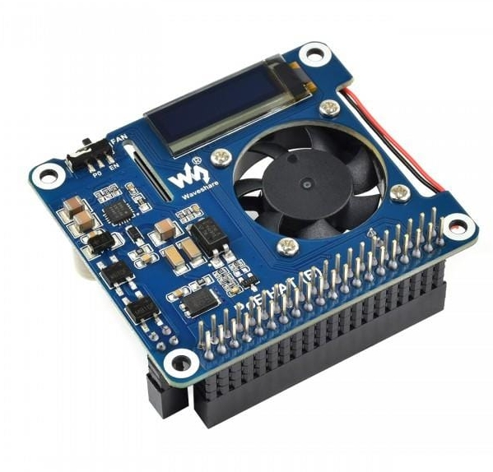
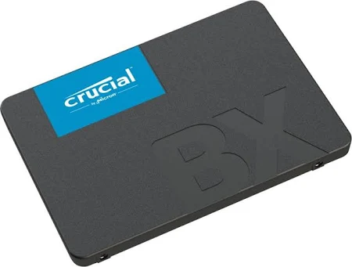
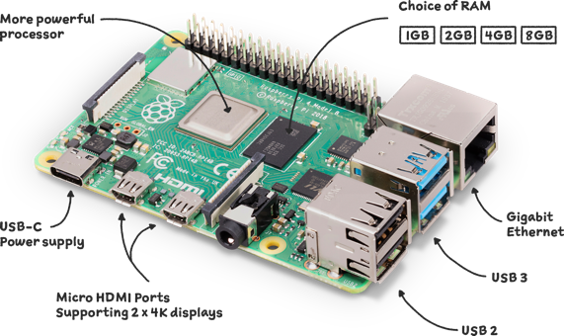
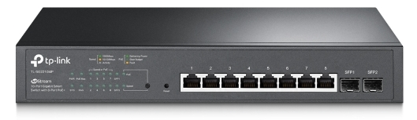
What does it look like?

Slide 16
What is different?
Downloadable image for booting RPi
No specialised HPC knowledge required to install and configure software and hardware
Updates and updated instructions
Adapted lessons
Expandable with regards to hardware and software

Slide 17
Status
EasyBuild - for installing software
Converting HPC lesson
Documenting
Scripting
Updating website
Volunteers needed!

Slide 18
All Done! Questions

